Slide 1
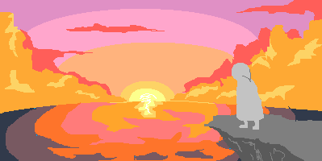
PINK SKY

Slide 2
Game Genre Idea
Side stepping platformer with an emphasis on exploration and interaction
-Story or gameplay driven → The main character must get from Point A to Point B to beat the game
-Simple premise that prompts for exploration in a visually appealing environment full of color and detail
-Focus on interaction with NPCs → learning about other people’s stories while trying to solve conflicts
-Through helping others, the player learns about the MC’s backstory, and their reason for going to their destination
-The player is not required to interact with the NPC’s → They will still have some agency within the gameplay

Slide 3
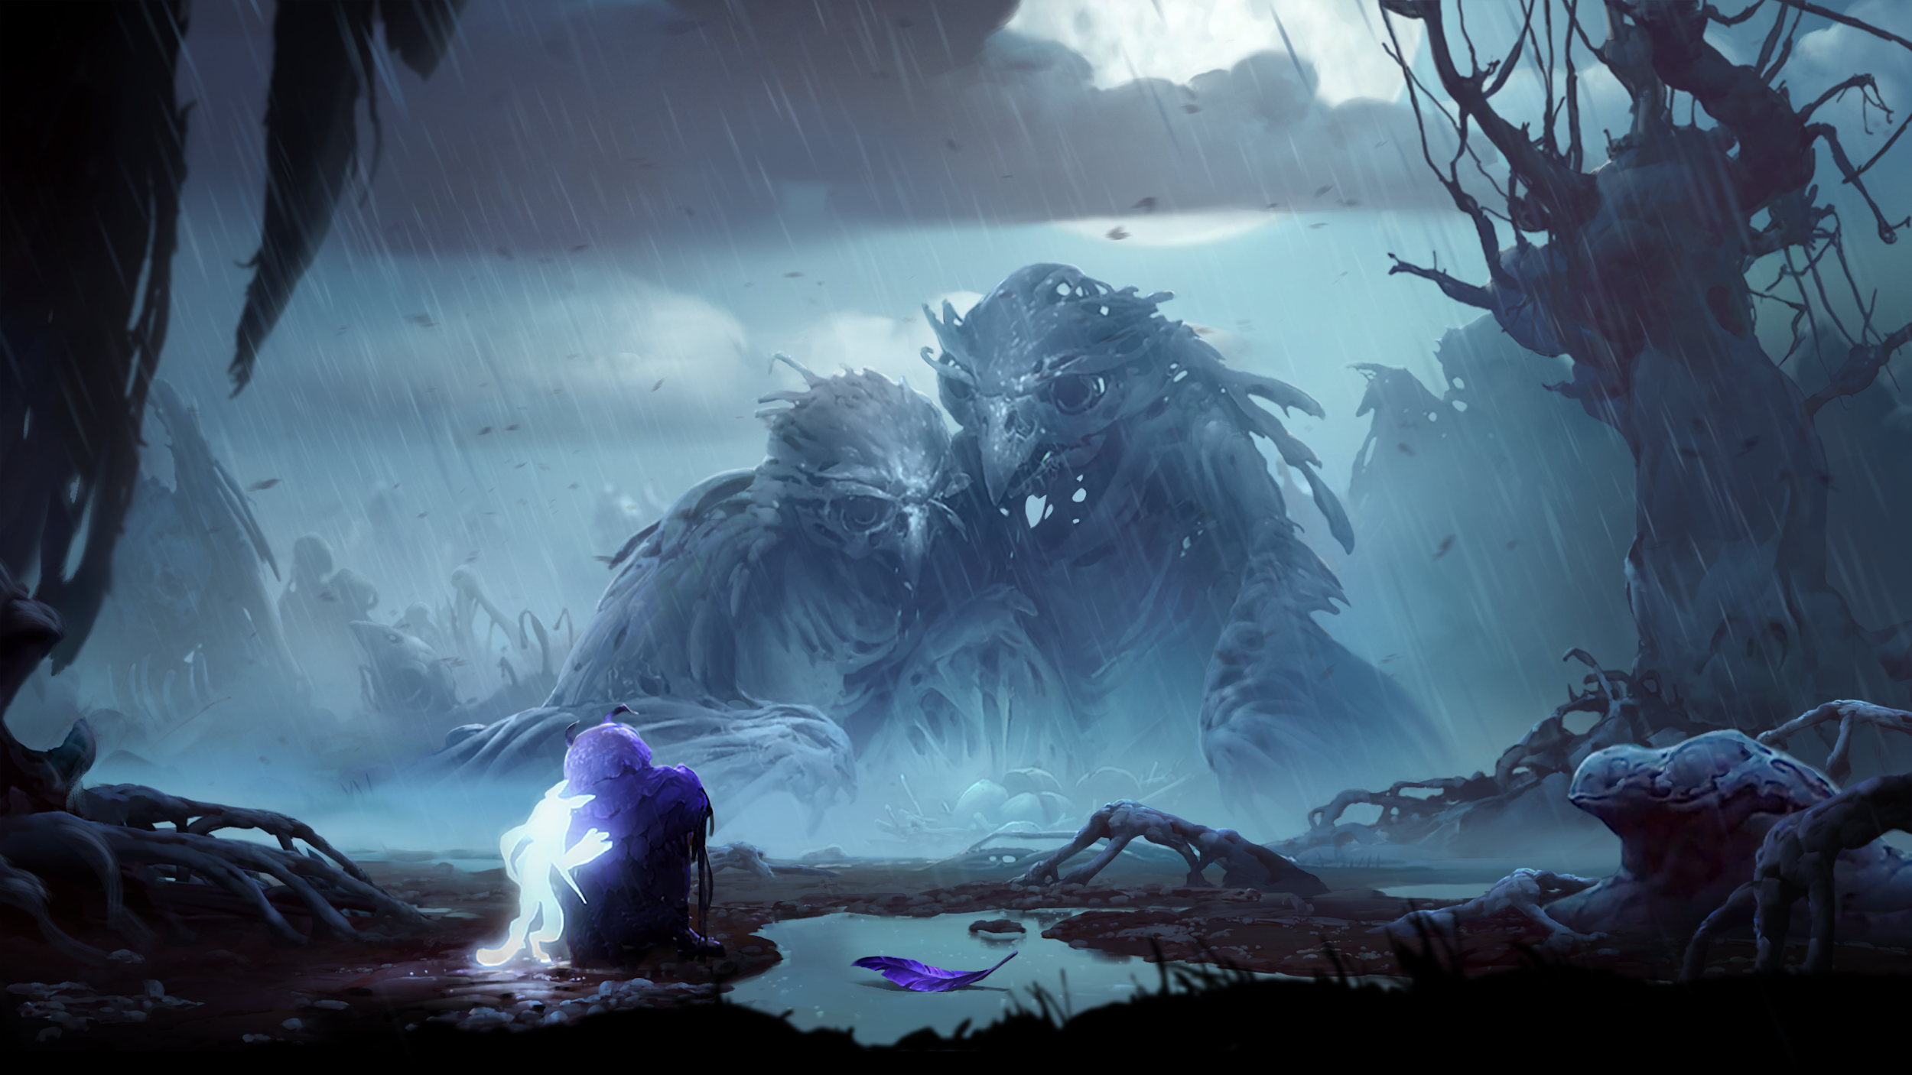
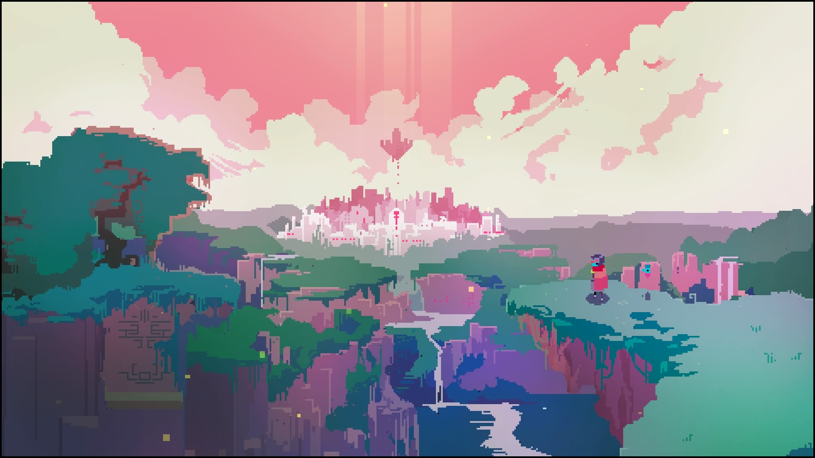
Artistic References
Ori and the Will of Wisps
Hyper Light Drifter

Slide 4
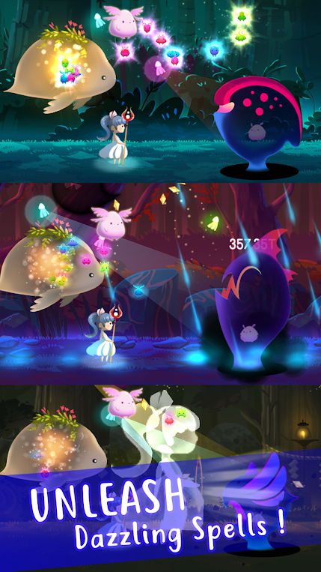
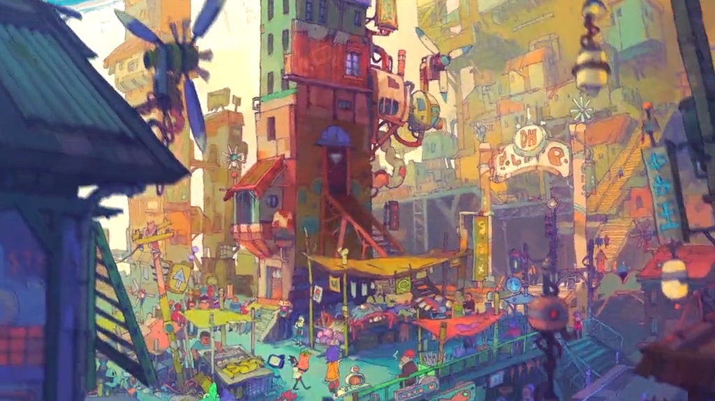
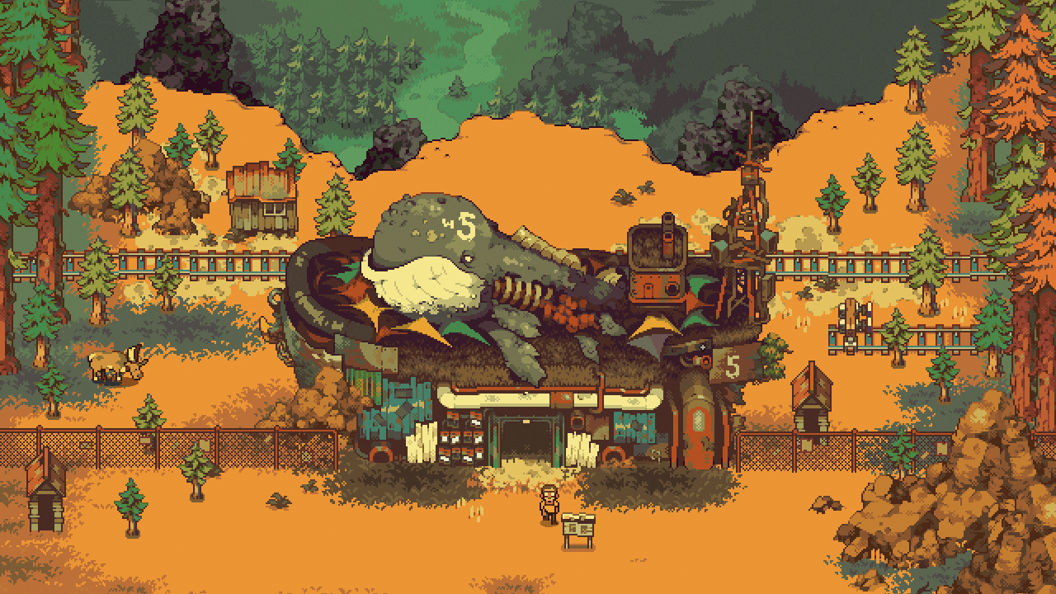
Light a Way:
https://play.google.com/store/apps/details?id=com.appxplore.lightaway&hl=en
Eastward: https://www.youtube.com/watch?v=4Jvne3fOwj8

Slide 5
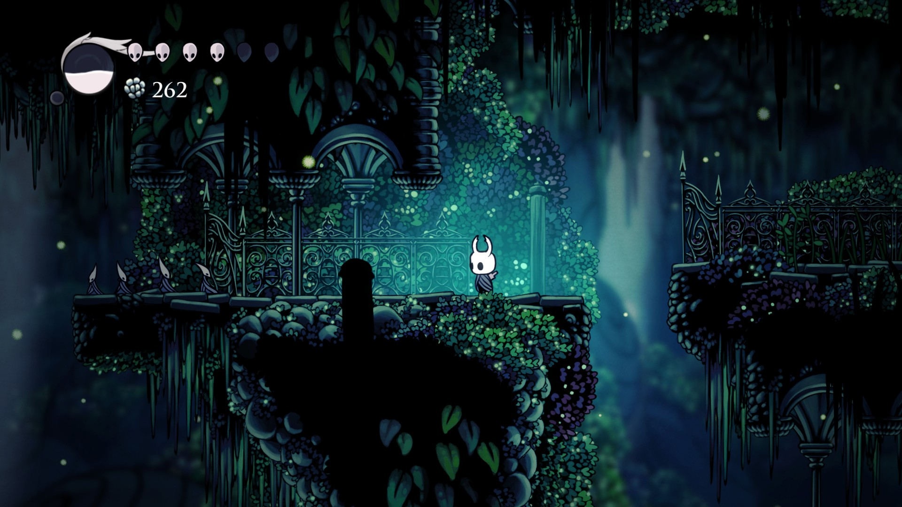
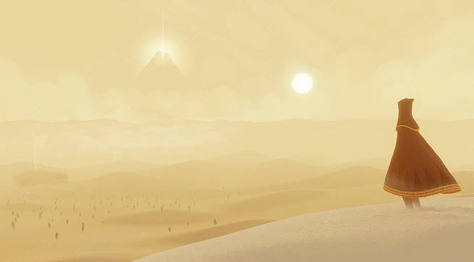
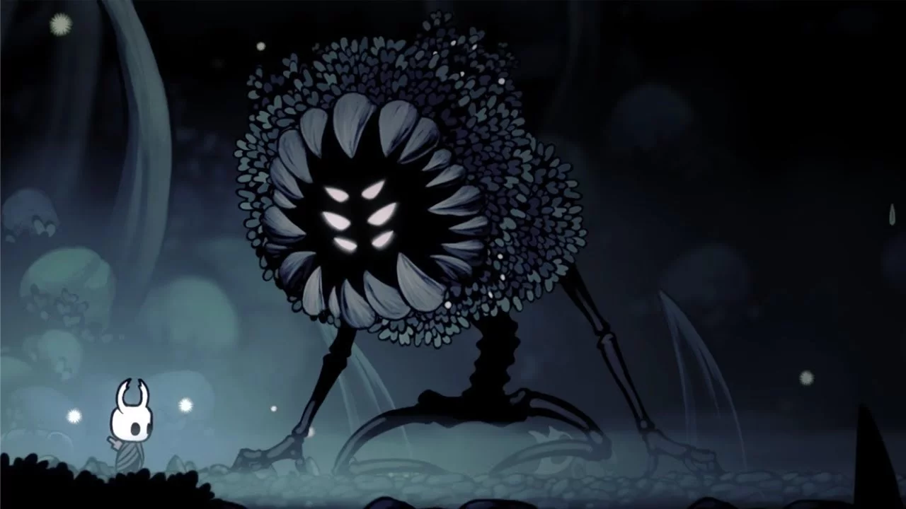
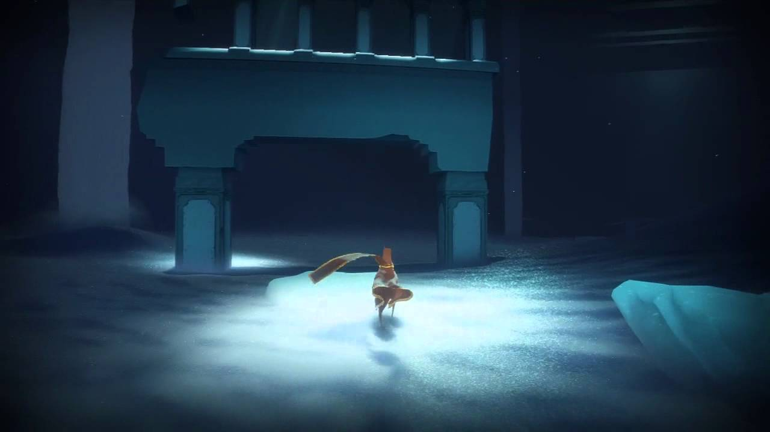
Gameplay References
Hollow Knight
Journey

Slide 6
Main Points to Work On:
Narrative-wise:
Coming up with different conflicts that the player can help work through, but they’re optional. The more the player tries to invest their time in the stories of others, the more they learn about themselves.
If the player decides to merely explore and not talk to anyone, the player will not know anything about the reason why the Main Character is going where they’re going.
Art-Wise:
A lot of the developmental focus will go towards the presentation of the environment, which would be a colorful, pixelated art style. The idea is to make the exploration just as entertaining as investing time in other’s stories.
Some jumping and movement will be involved, but the main mechanics will involve interaction with objects and characters.
The interface will remain minimalistic, with only a few sets of controls available for use.

Slide 7
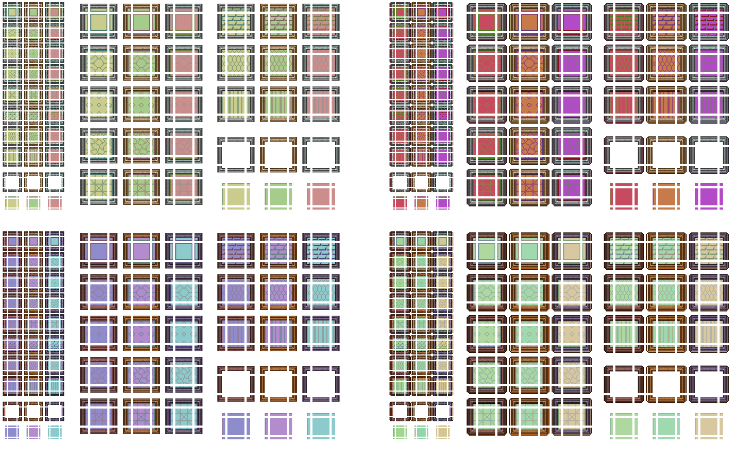
Starting Point
We would start by designing a small village with NPCs, and really delve into how the character can fix the conflicts that they face. The focus would lie in interactions and choices.

Slide 8
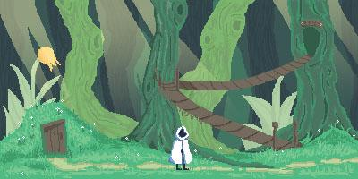
Sample Art
Here is a sample of an environment that we made, portraying the style and ambience that we’re trying to pursue.

Slide 9
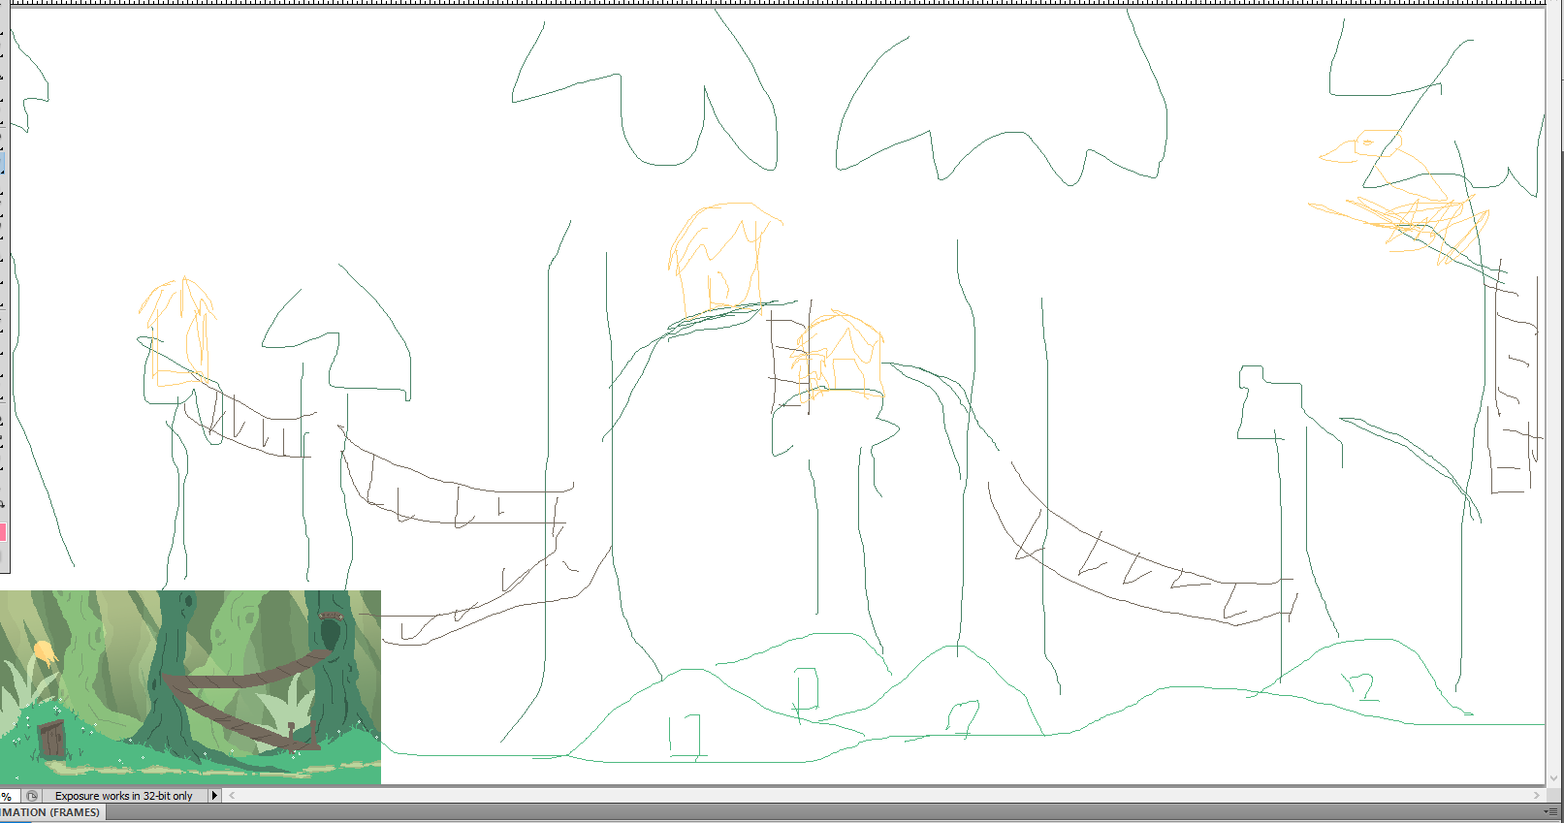
Sample Sketches

Slide 10
